Slide 1

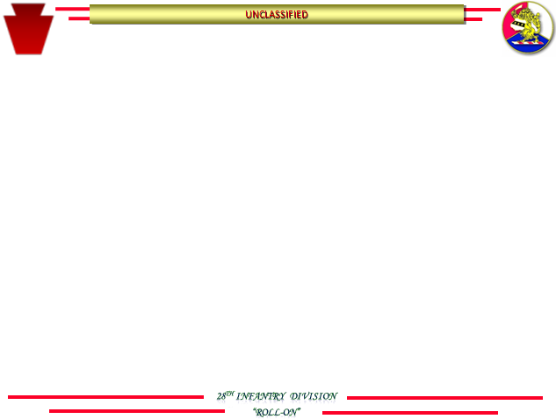



28th ID Unit Locations
111th Infantry Regiment - Yankee Doodle Dandy
I’m a Yankee Doodle Dandy
Yankee doodle, do or die
A real live Nephew of my Uncle Sam
Born on the Fourth of July
I’ve got a Yankee Doodle sweetheart
She’s my Yankee Doodle Joy
Yankee Doodle came to London
Just to ride the ponies
I am a Yankee Doodle boy.

